Slide 1
Discovering your superpowers! Understanding Cloud Application Models

Slide 3

Ryan Nowak
Azure Incubations (Azure CTO’s Office)
Formerly: ASP.NET Core architect for MVC/Razor/Blazor
Current Focus: Open Application Model - https://oam.dev/
I like:
Designing useful tools for developers
Open Source
Lots of different languages and technologies
@aVerySpicyBoi
rynowak (github)

Slide 4
Agenda
What is an Application Model?
How can we think systematically about cloud runtimes?
Superpowers!
How can we learn new cloud technologies faster?
How can we be more productive?
How can we write application code that’s more flexible?

Slide 5
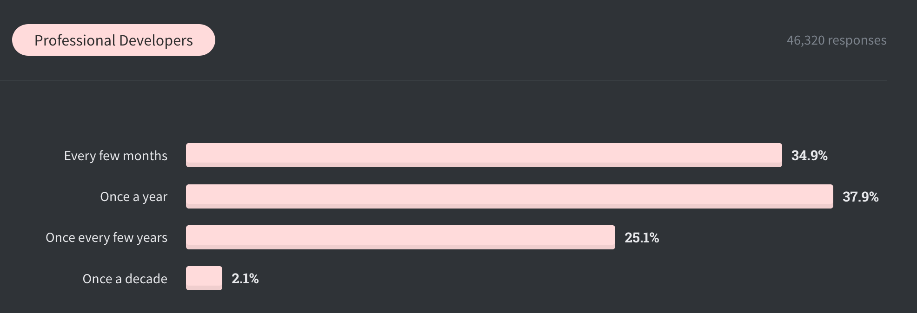
How often do you learn a new technology?
From: Stack Overflow 2020 developer survey

Slide 6
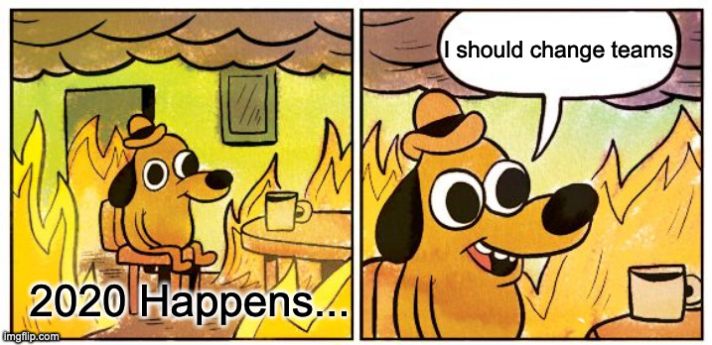
My Journey in 2020
In the last few years:
I’ve had many conversations with .NET developers about microservices
We organize surveys, interviews, and trials for .NET microservices tech
Everything except your code is a pain point for developers!
I moved to Azure:
Now I’m working on solutions to these problems

Slide 7
What is an Application Model?

Slide 8
A useful definition
An Application Model describes the interface between software components and a runtime environment..
Me

Slide 9
Some Examples
Software Components
Process
Container
Interface
Environment Variables
Runtime Environment
OS
Docker
"Hosted" Application
Networking
Files
Kubernetes
FaaS (Azure Functions)
Website PaaS (Azure Web Apps)
Deployment
Platform behaviors (many more)

Slide 10
When I talk to developers…
Learning cloud technologies like Kubernetes or Docker is frustrating
Development and production are different
My theories:
We deploy as the last step … it works on my machine and then …
We become users ... we learn someone else’s software but ...
The concepts we understand don’t match the features offered

Slide 11
Impedance mismatch
Alternate title: Different levels of abstraction
Connect to database
Environment variables

Slide 12

Yak Shaving
To connect to a database we must:
Choose an environment variable name
Figure out the right connection string
Figure out how to set an environment variable in the deployment platform (without checking in a secret)
Test it in production (and repeat if you got it wrong)
Now figure out the next problem and repeat

Slide 13
Applying systematic thinking - the humble process

Slide 14
What did we find?

Slide 15
And then for a long time nothing happened…

Slide 17
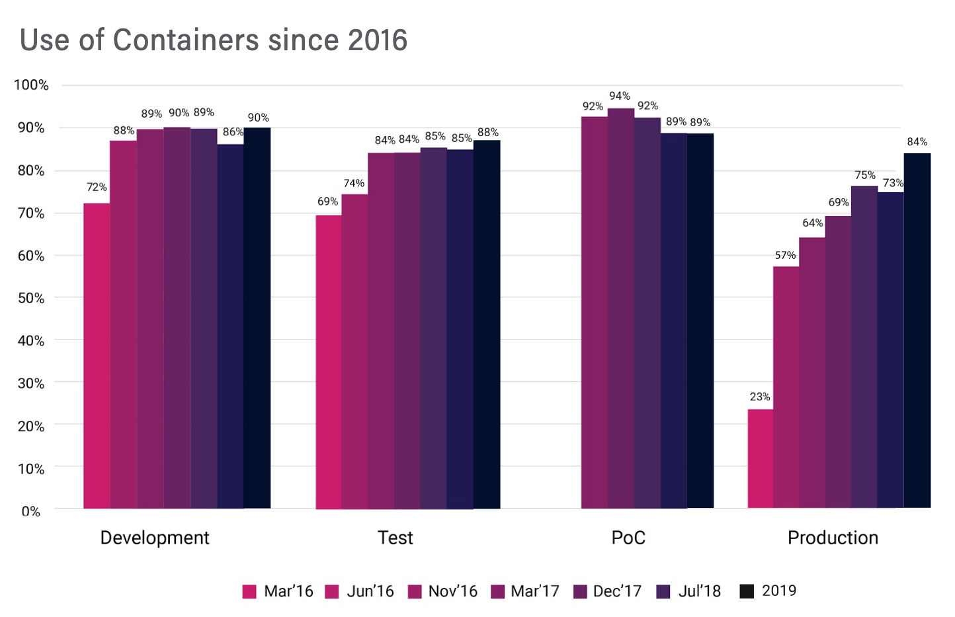
CNCF survey https://www.cncf.io/wp-content/uploads/2020/08/CNCF_Survey_Report.pdf

